Slide 1
Algorithms: Greedy Algorithms
For: CSCI 163A / COEN 179
By: Navid Shaghaghi

Slide 2
The Greedy Technique
Constructing a solution through a sequence of steps, each expanding a partially constructed solution obtained so far, until a complete solution to the problem is reached.
On each step the choice made must be:
Feasible: it has to satisfy the problem’s constraints
Locally optimal: it has to be the best local choice among all feasible choices available on that step
Irrevocable: once made, it cannot be changed on subsequent steps of the algorithm

Slide 3
Why Called Greedy?
On each step, it suggests a “greedy” grab of the best alternative available in the hope that a sequence of locally optimal choices will yield a (globally) optimal solution to the entire problem.
As a rule, greedy algorithms are both
intuitively appealing and
simple.
What is usually more difficult is to prove that a greedy algorithm yields an optimal solution (when it does).

Slide 4
Proof of Greedy Approach
Mathematical induction
Base Case
Inductive Step
Show that on each step it does at least as well as any other algorithm could in advancing toward the problem’s goal. See Example 1
Show that the final result obtained by a greedy algorithm is optimal based on the algorithm’s output rather than the way it operates. See Example 2

Slide 5
Example 1
Find the minimum number of moves needed for a chess knight to go from one corner of a 100 × 100 board to the diagonally opposite corner. (The knight’s moves are L-shaped jumps: two squares horizontally or vertically followed by one square in the perpendicular direction.)
A greedy solution: jump as close to the goal as possible on each move.
If its start and finish squares are (1,1) and (100, 100), respectively, a sequence of 66 moves such as (1,1)−(3,2)−(4,4)−...−(97,97)−(99,98)−(100,100) solves the problem.
(The number k of two-move advances can be obtained from the equation 1 + 3k = 100.)

Slide 6
Example 1 - Continued
Why is this a minimum-move solution?
Because if we measure the distance to the goal by the Manhattan distance, which is the sum of the difference between the row numbers and the difference between the column numbers of two squares in question, the greedy algorithm decreases it by 3 on each move—the best the knight can do.

Slide 7
Example 2
Place the maximum number of chips on an 8 × 8 board so that no two chips are placed on the same or adjacent— vertically, horizontally, or diagonally—squares.
A greedy strategy: place each new chip so as to leave as many available squares as possible for next chips.
For example, starting with the upper left corner of the board, we will be able to place 16 chips as shown in the figure on the next slide.

Slide 8
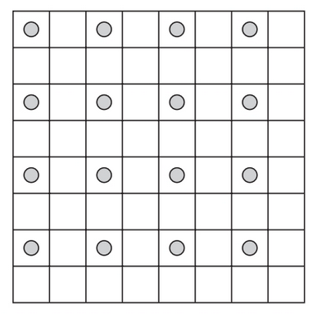
Example 2 - Continued

Slide 9
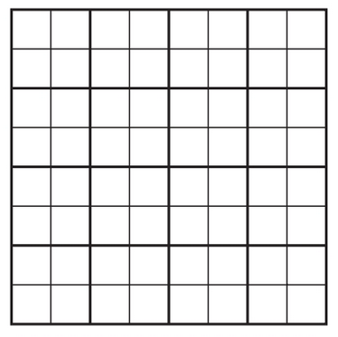
Example 2 - Continued
Why is this solution optimal?
Partition the board into sixteen 4 × 4 squares as shown. Obviously, it is impossible to place more than one chip in each of these squares, which implies that the total number of nonadjacent chips on the board cannot exceed 16.

Slide 10
Minimum Spanning Tree Problem
The problem of finding a minimum spanning tree for a given weighted connected graph
Spanning tree: a connected acyclic subgraph (i.e., a tree) that contains all the vertices of the original graph.
Minimum spanning tree is a spanning tree of the smallest weight, where the weight of a tree is defined as the sum of the weights on all its edges.

Slide 11
Constructing a minimum spanning tree by exhaustive search
Need to search all permutations of possible spanning trees of the given graph and then determine which one(s) is the minimum.

Slide 12
Constructing a minimum spanning tree by exhaustive search Continued
Obstacles:
The number of spanning trees grows exponentially with the graph size
Generating all spanning trees for a given graph is not easy; in fact, it is more difficult than finding a minimum spanning tree for a weighted graph
Instead let’s explore some greedy algorithms for achieving this task.

Slide 13
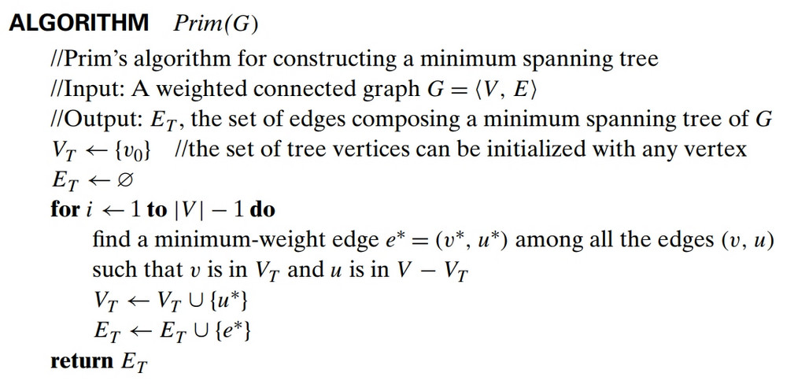
Prim’s Algorithms

Slide 14
Example

Slide 15
Example Continued

Slide 16
Correctness Proof
Proof by induction:
Base case: The starting single node is a spanning tree
Inductive Step: Adding the next node using the smallest weighted edge does not create a loop (proof vis contradiction) therefore the inductive step results in also a minimum spanning tee.
See page 320 for more details

Slide 17
How efficient is Prim’s algorithm?
The answer depends on the data structures chosen for the graph itself and for the priority queue of the set V − V_{T} whose vertex priorities are the distances to the nearest tree vertices.
If a graph is represented by its weight matrix and the priority queue is implemented as an unordered array, the algorithm’s running time will be in Θ(|V|²).
on each of the |V | − 1 iterations, the array implementing the priority queue is traversed to find and delete the minimum and then to update, if necessary, the priorities of the remaining vertices.
If a graph is represented by its adjacency lists and the priority queue is implemented as a min-heap, the running time of the algorithm is in O(|E| log |V |).
The algorithm performs |V | − 1 deletions of the smallest element and makes |E| verifications. Each of these operations, is a O(log |V |) operation so (|V| − 1 + |E|) O(log |V|) = O(|E| log |V|)

Slide 18
Kruskal’s Algorithm

Slide 19
Example

Slide 20
Example Continued

Slide 21
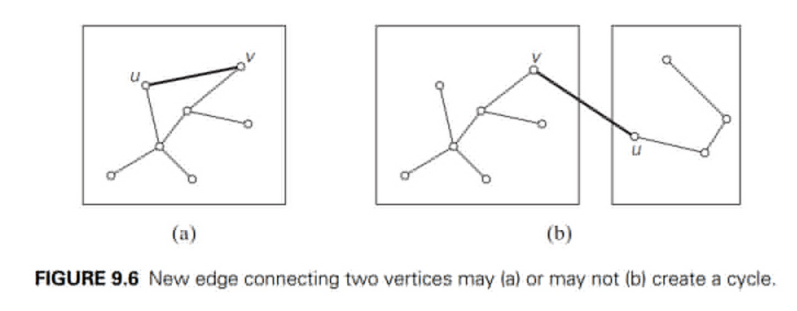
Kruskal’s Algorithm is more difficult than Prim’s Algorithm
Kruskal’s algorithm has to check whether the addition of the next edge to the edges already selected would create a cycle:

Slide 22
Union-Find
Check for whether two vertices belong to the same tree.
With an efficient union-find algorithm, the running time of Kruskal’s algorithm will be dominated by the time needed for sorting the edge weights of a given graph.
Time efficiency of Kruskal’s algorithm will be in O(|E| log |E|).

Slide 23
Union-Find
makeset(x) creates a one-element set {x}. It is assumed that this operation can be applied to each of the elements of set S only once.
find(x) returns a subset containing x.
union(x, y) constructs the union of the disjoint subsets Sx and Sy containing x and y, respectively, and adds it to the collection to replace Sx and Sy, which are deleted from it

Slide 24
Example
Let S = {1, 2, 3, 4, 5, 6}.
makeset(i) creates the set {i} and applying this operation six times initializes the structure to the collection of six singleton sets: {1}, {2}, {3}, {4}, {5}, {6}.
union(1, 4) and union(5, 2) yield {1, 4}, {5, 2}, {3}, {6}
Then union(4, 5) and union(3, 6), yield {1, 4, 5, 2}, {3, 6}.
Most implementations of this abstract data type use one element from each of the disjoint subsets in a collection as that subset’s representative. Example: union(4, 5)

Slide 25
two principal alternatives for implementing this data structure
Quick Find
Quick Union

Slide 26
Quick find
Uses an array indexed by the elements of the underlying set S; the array’s values indicate the representatives of the subsets containing those elements.
Each subset is implemented as a linked list whose header contains the pointers to the first and last elements of the list along with the number of elements in the list

Slide 27
Analysis
makeset(x) – includes assigning the corresponding element in the representative array and initializing the corresponding linked list to a single node with x as the value for all n values in the set: n * Θ(1) = Θ(n)
find(x) – looking up x in the array to return its corresponding linked list: Θ(1)
union(x) – Appending the y’s list to the end of the x’s list, hence updating the representative for all of the elements in y, and then delete y’s list from the collection: Θ(n²)

Slide 28
Analysis continued
Quick Find = Θ(n) + Θ(1) + Θ(n²) = Θ(n²) in worst case.
An enhancement (called union by size) would be to always append the shorter list to the longer list. Although this will not change the worst case running time it will result in an average case efficiency of Θ(nlogn).
Proof: See page 330.

Slide 29
Quick Union
Each subset is represented by a rooted tree.
The nodes of the tree contain the subset’s elements (one per node), with the root’s element considered the subset’s representative;
the tree’s edges are directed from children to their parents
An array of pointers mapping the set elements to their tree nodes is maintained.

Slide 30
Analysis
makeset(x) – creation of n single node trees: n * Θ(1) = Θ(n)
union(x) – attaching the root of the y tree to the root of the x tree and setting the pointer to y’s root to null: Θ(1)
find(x) – following the pointer chain from the node containing x to the root: Θ(n) because a tree can be a linked list at worst case.
This can be improved by always appending smaller trees to the larger trees thus reducing the find to an average of Θ(log n).

Slide 31
Single Source Shortest Path Problem
Finding a family of paths,
each leading from the source to a different vertex in the graph,
with some having edges in common.

Slide 32
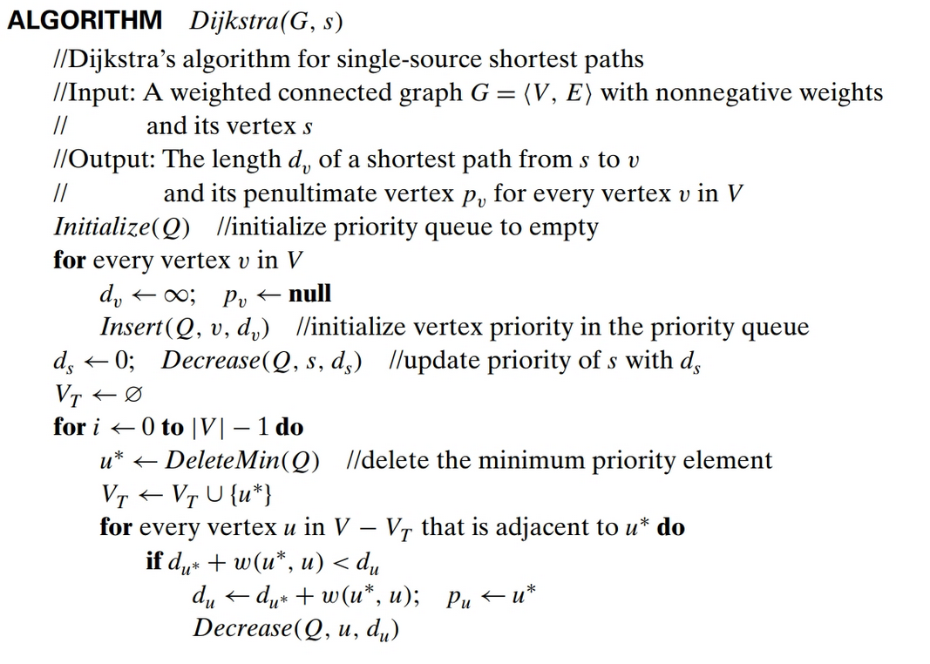

Slide 33
Example

Slide 34
Example Continued

Slide 35
Analysis
The time efficiency of Dijkstra’s algorithm depends on the data structures used for implementing the priority queue and for representing an input graph itself.
For example:
If the graphs is represented by a weight matrix and the priority queue is implemented as an unordered array : Dijkstra’s running time is in Θ(|V|²)
If the graphs is represented by an adjacency lists and the priority queue is implemented as a min-heap, Dijkstra’s running time is in O(|E| log |V|).

Slide 36
Encoding
Fixed-length encoding
Assign to each symbol a bit string of the same length m (m ≥ log₂ n)
One way of getting a coding scheme that yields a shorter bit string on the average assigning shorter code- words to more frequent symbols and longer codewords to less frequent symbols. Example:
Morse Code - frequent letters such as e (.) and a (.−) are assigned short sequences of dots and dashes while infrequent letters such as q (− − .−) and z (− − ..) have longer ones

Slide 37
Encoding
Variable-length encoding
Assigns codewords of different lengths to different symbols
How can we tell how many bits of an encoded text represent the ith symbol?
No codeword is a prefix of a codeword of another symbol
with such an encoding, we can simply scan a bit string until we get the first group of bits that is a codeword for some symbol, replace these bits by this symbol, and repeat this operation until the bit string’s end is reached.
Example: Huffman encoding

Slide 38
Creating binary prefix code for some alphabet
Associate the alphabet’s symbols with leaves of a binary tree in which all the left edges are labeled by 0 and all the right edges are labeled by 1.
The codeword of a symbol can then be obtained by recording the labels on the simple path from the root to the symbol’s leaf.
Since there is no simple path to a leaf that continues to another leaf, no codeword can be a prefix of another codeword.

Slide 39
Huffman encoding
Step 1: Initialize n one-node trees and label them with the symbols of the alphabet given. Record the frequency of each symbol in its tree’s root to indicate the tree’s weight (sum of the frequencies in the tree’s leaves).
Step 2: Find two trees with the smallest weight (ties can be broken arbitrarily), make them the left and right subtree of a new tree, and record the sum of their weights in the root of the new tree as its weight.

Slide 40
Example: Task
Consider the five-symbol alphabet {A, B, C, D, _} with the following occurrence frequencies in a text made up of these symbols:

Slide 41
Example: Constructing Huffman Tree

Slide 42
Example: Constructing Huffman Tree

Slide 43
Example: Huffman Encoding Result
Average number of bits per symbol:
∑ # bits * weight = 2 . 0.35 + 3 . 0.1 + 2 . 0.2 + 2 . 0.2 + 3 . 0.15 = 2.25.
Vs. 3bits needed for a fixed-length encoding

Slide 44
Compression Ratio
A standard measure of a compression algorithm’s effectiveness
Measured as (fixed-length – variable-length) / fixed-length * 100%
Huffman’s encoding of the text will use (3 − 2.25)/3 * 100% = 25% less memory than its fixed-length encoding.
Huffman codes’ compression ratio typically fall between 20% and 80%.
As a result, Huffman’s encoding is one of the most important file-compression methods.

